Slide 1
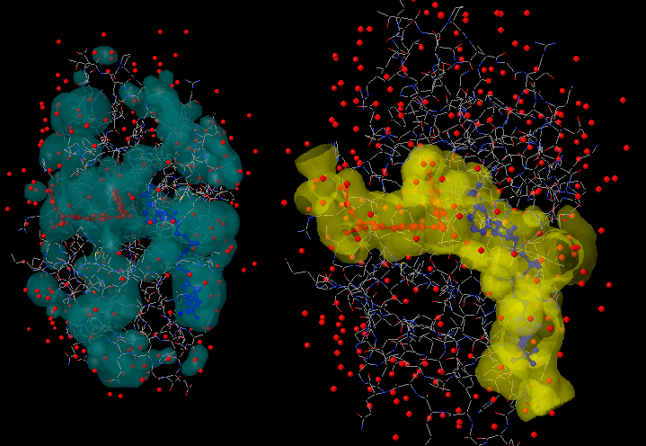
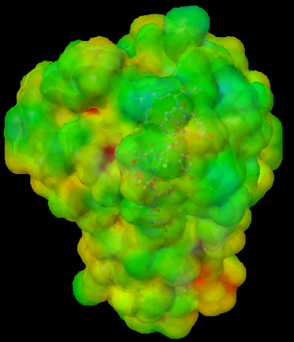
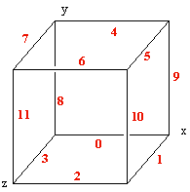
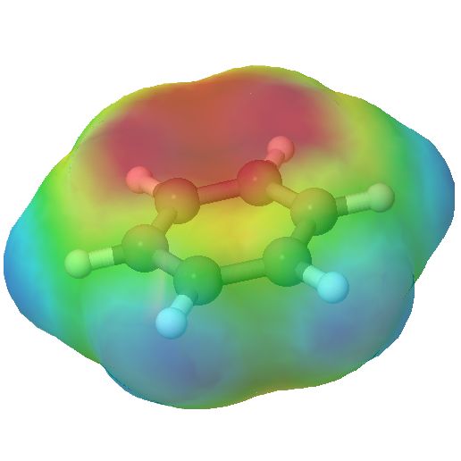
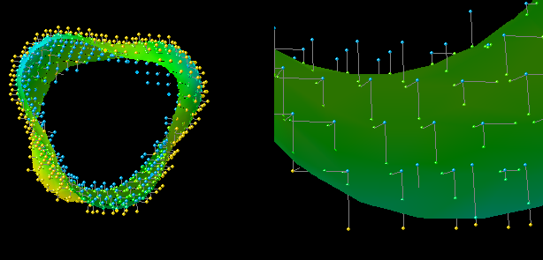
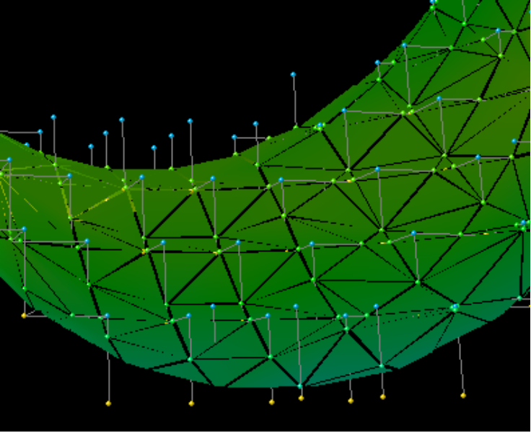
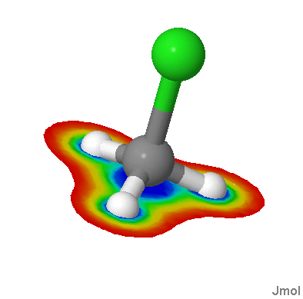
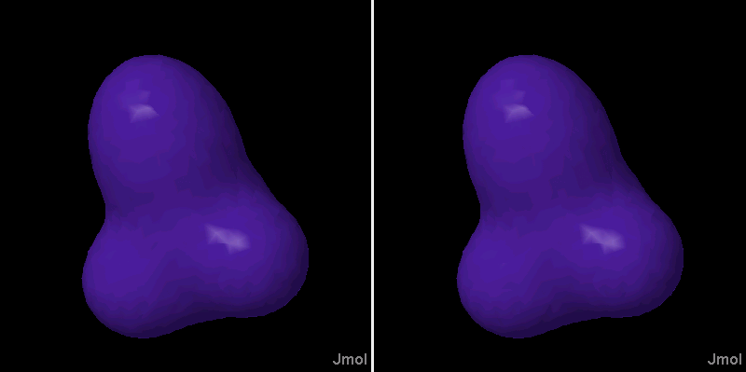
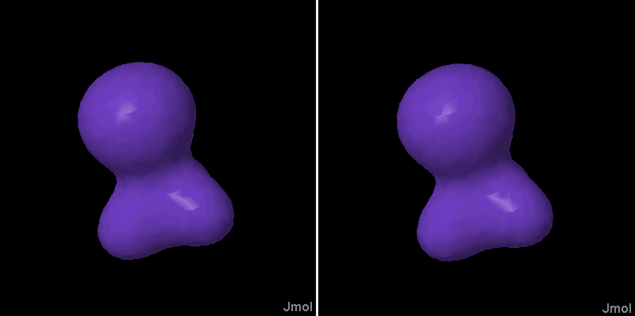
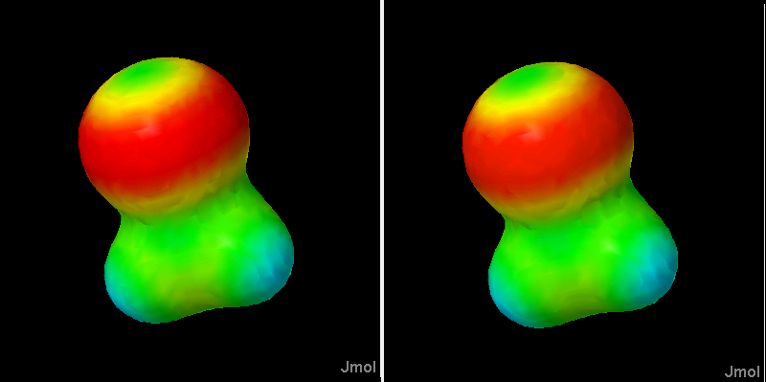
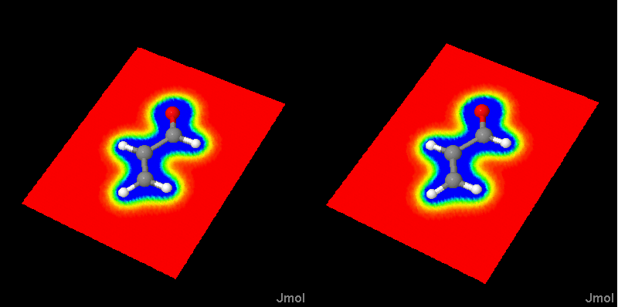
The Jmol Voxel (JVXL) File Format:
Efficient Delivery of Isosurfaces Over the Web
Robert M. Hanson
Department of Chemistry
St. Olaf College, Northfield, MN
The purpose of the Jmol voxel (JVXL) file format is to provide a mechanism for the efficient delivery of molecular surface data (orbitals, electron density plots, electrostatic potential maps, solvent surfaces, etc.) from a web server to a client page in a compact manner. The format was designed to be used specifically with the open-source Jmol molecular viewing and analysis applet (http://jmol.sourceforge.net), but the format has general utility anywhere the Marching Cubes algorithm is used for isosurface construction. Compared to data formats such as Gaussian CUBE files, which contain a three-dimensional matrix of data, the derived JVXL files are 400-1000 times smaller. Jmol can read and write the JVXL file format and is currently the only application that can be used to create JVXL files.
Note that the resultant client model is fully manipulable and scalable in 3D, not just an image.
Reference URL: http://chemapps.stolaf.edu/jmol
Cavities in 3dfr.pdb rendered using Jmol;
file sizes 27K (left), and 37K (right).
A map of the electrostatic potential of 1dry.pdb
onto the van der Waals-radius surface. (65K)
The Method
The Marching Cubes algorithm is run as for any isosurface, based on a grid of scalar values and a given cutoff value. The critical edges are identified. We simply count the number of points alternately “outside” and “inside” the surface.
The interpolated surface intersection point is identified as a distance along the critical edge, expressed as a number between 0 and 90. This number is encoded as a ASCII digit in the range 35 – 124, inclusive, with 92 (backslash) recorded as 33 (exclamation point). ASCII 125 “}” is reserved for indicating no value, thus allowing for surface fragments.
0.0 . . . . 1.0
#$%&’()*+,-./0123456789:;<=>?@ABCDEFGHIJKLMNOPQRSTUVWXYZ[!]^_`abcdefghijklmnopqrstuvwxyz{|
0 (ASCII 35) . . . . 89 (ASCII 124)
Note that this format allows for the information to be passed within doubly-quoted strings, and with any number of line breaks.
Finally, if the surface point is to be mapped with a value from another grid, that value is base90-encoded in the same way as the intersection point, with the option to encode the remainder as a second base90 value, thus allowing for a precision of 1 part in 8100 if desired. (This was found important for planar surfaces.)
Sample File
JVXL solvent-excluded surface
range (-3.6571667, -3.3279688, -1.95) to (3.6571667, 3.3279688, 1.95)
-12 -6.9110436 -6.28895 -3.684966
24 0.6581947 0.0 0.0
22 0.0 0.6619947 0.0
14 0.0 0.0 0.6699939
1 1.0 4.643372 0.0 0.0
6 6.0 2.616899 0.0 0.0
6 6.0 -2.616899 -0.0 0.0
6 6.0 1.3084495 2.2663012 0.0
6 6.0 1.3084495 -2.2663012 0.0
6 6.0 -1.3084495 -2.2663012 0.0
6 6.0 -1.3084495 2.2663012 0.0
1 1.0 2.3216863 4.0212784 0.0
1 1.0 2.3216863 -4.0212784 0.0
1 1.0 -2.3216863 -4.0212784 0.0
1 1.0 -2.3216863 4.0212784 0.0
1 1.0 -4.643372 -0.0 0.0
-1 35 90 35 90 Jmol voxel format version 0.9f
#
# load C6H6.smol;isosurface delete resolution 3 solvent map mep
0.0 1347 1272 1272 -0.09553222 0.036691315 -0.09553222 0.036691315
424 4 10 4 10 4 10 4 248 4 9 6 8 6 8 6 8 6 9 4 207 2 10 6 8 6 7 8 6 8 6 8 6 8 7 6 8 6 10 2 138 2 11 4 9 6 8 6 7 8 6 8 5 10 4 10 4 10 4 10 5 8 6 8 7 6 8 6 9 4 11 2 82 2 11 4 9 6 7 8 6 8 6 8 5 10 4 10 4 10 4 10 4 10 4 10 5 8 6 8 6 8 7 6 9 4 11 2 67 4 9 6 7 8 6 8 5 10 4 10 4 10 4 10 4 10 4 10 4 10 4 10 4 10 4 10 5 8 6 8 7 6 9 4 66 4 9 6 7 8 5 10 4 10 4 10 4 10 4 10 4 10 4 10 4 10 4 10 4 10 4 10 4 10 5 8 7 6 9 4 66 4 8 8 5 10 4 10 4 10 4 10 4 10 4 10 4 10 4 10 4 10 4 10 4 10 4 10 4 10 4 10 5 8 8 4 66 4 8 8 5 10 4 10 4 10 4 10 4 10 4 10 4 10 4 10 4 10 4 10 4 10 4 10 4 10 4 10 5 8 8 4 66 4 9 6 7 8 5 10 4 10 4 10 4 10 4 10 4 10 4 10 4 10 4 10 4 10 4 10 4 10 5 8 7 6 9 4 66 4 9 6 7 8 5 10 4 10 4 10 4 10 4 10 4 10 4 10 4 10 4 10 4 10 4 10 4 10 5 8 7 6 9 4 66 4 8 8 5 10 4 10 4 10 4 10 4 10 4 10 4 10 4 10 4 10 4 10 4 10 4 10 4 10 4 10 5 8 8 4 66 4 8 8 5 10 4 10 4 10 4 10 4 10 4 10 4 10 4 10 4 10 4 10 4 10 4 10 4 10 4 10 5 8 8 4 66 4 9 6 7 8 5 10 4 10 4 10 4 10 4 10 4 10 4 10 4 10 4 10 4 10 4 10 4 10 5 8 7 6 9 4 66 4 9 6 7 8 6 8 5 10 4 10 4 10 4 10 4 10 4 10 4 10 4 10 4 10 4 10 5 8 6 8 7 6 9 4 67 2 11 4 9 6 7 8 6 8 6 8 5 10 4 10 4 10 4 10 4 10 4 10 5 8 6 8 6 8 7 6 9 4 11 2 82 2 11 4 9 6 8 6 7 8 6 8 5 10 4 10 4 10 4 10 5 8 6 8 7 6 8 6 9 4 11 2 138 2 10 6 8 6 7 8 6 8 6 8 6 8 7 6 8 6 10 2 207 4 9 6 8 6 8 6 8 6 9 4 248 4 10 4 10 4 10 4 1070
A_8nYnYA8@3XvvXl3XvvXl_8YY8@^11^JFGhnhnJGYXXEXEG:kke:kkeXEEGGFGnnGGYU77U-i'-'6$|#dSjjdS$##$hh{{PP{PO:gge:ggePPPO$$hh${|#SjjS##{;i'';6{rr4!-4-C=n+GG=+1%z$K^^K%$%KEmmET5t-5-+;{{dIm=I=2Z[[EZ[[Em==2V;{{Vdt--+jKEmmEjTz$K^^K$%zn+GG+z1b!--bCkk@/E@Epv.fvfqjMIjIREf9E99C^^!1nUlKUK3IV7h7hIVlKK3J1JnC^^!f999ZMIIZR5.ff5q)/EE)p__MAtllMt^!Pm!mOF]MFMB&ytbOtO=XeeGOP7h'x'x7hOPXeeGbOO=+&+y]MMBYPmmYOCAttC^R33R!.yy!qr(rww2wmc[vcvD?`5j:e4k&y&y4k:e5j?`[vvD<2<m(((w-.-qC&&CM6kkMi3jiqq3i5)x:):'IV.q%z+t8g6i6i8g+t%z.qIVx::'vjiiv5l.6.ilR44R:ALL:^3joo35*w*(IV.q${+tB]SLSLB]+t${.qIVw(uju5l0A0^leSSe*h<<*7,_%_z,az/zpahXhG=b3l:eSLn1n1SL:e3l=bXG7a/7pa%,%%z,@h@7uccu*h<<*7_%_zz/zphXhG=b3l:eSLn1n1SL:e3l=bXG7/7p%%%z@h@7uccu:ALL:^3jsoo3s5*w>*>(IV.q${+tB]SLSLB]+t${.qIVw>>(ujssu5l0A0^leSSeM6kkMi3jqq35)x)'IV.q%z+t8g6i6i8g+t%z.qIVx'vjv5l.6.ilR44R!.yy!q6r(rw6ew2wmec[cD?`5j:e4k&y&y4k:e5j?`[D<e2<me(6((w6-.-qC&&CMAllM^!P!OF]FB)&y)tbt=XGOP7h'x'x7hOPXGb=+)&+y)]BYPYOCAC^R33R+@/@p+2v.vq2RjMjRREfE9PC!P:1n:UlU3IV7h7hIVl3J:1Jn:PC!Pf9ZRMZRR52.5q2)+/)p+__ZZ94!4C9V=n=1Vf%z%%fAKTA5t5+T;dTImI2ZEZEm2VT;VdTt+jAKjTAfz%fzVnz1Vb9!bC9kZkZrrtXXt{TAAT{Z2-i-62Zr$|dd$#r$${$b{P{ObD:eDD:eDbPOb$$$${$r|#r{Z;2i;62{Z{TrArAT{tXXtrrxx|L55L|7JFhhJY7OXXXGO8:e88:e8OXGOG7FGY7|UL7575UL|xxX11XZA_nnA@Z43l443l4Z_@Z^X1111^XgFFgG))GG))GgFFg
yxyy|y|yyxw{||{ww{||{wxy||yxyyyyrqutxtxruqpospsonvvnnvvnossopquxxupqrttrnmmnmmfffjmqqjmfffbllbb`fbf``ii``ii``ff`bbllbbffmqqmfffjmmmjmfnn{zz{zzwuvxxwvujjjorrojjjaejjea![!!![WbbWVVXVXVU[[UU[[UVXXVVWbbVW[!![!aejje!ajjorrojjjuvxxvjuwzzzwz{{|{|||{zvyzyvumquqmebcecbY^^YSSQORQROM~7 ORROQSQSY^^Ybccbemqqemuvyyuvz{||z{||{xz||{zxvruvuriehihe[[ZSVZVSLQQLGGE~7 GGLQQLSVVSZ[Z[ehheiruuirvxzzvx{||{yu{{yutjtji^i^[UZ[ZUNNGGAA=~7 AAGGNNUZZU[^[^ijijtutuy{{ywryywrfdippfidZYZZZYQQJJCC<<66444466<<CCJJQQYZZYZdiiZdfprprfwyywplttpla_jja_VUVUMMFF??8800****0088??FFMMUUV_V_ajljlapttpkjnnkj]e]e]]U]S]SUQJQJCC;;33**####**33;;CCJJQUSQSU]~5 ejejknnkkjnnkje]e]]S]SQJQJCC;;33**####**33;;CCJJQSQS]]]]ejejknnkplttpla_]jja]_VUUVUUMMFF??8800****0088??FFMMUUUUV_]]V_ajljlapttpwryywrfdppfdZYZYQQJJCC<<66444466<<CCJJQQYYZdZdfprprfwyywyu{{yuitjtjiZi^i^Z[U[UNNGGAA=~7 AAGGNNUU[Z^[^Ziijijitutuy{{y{x||{xvrvrieieZ[[ZZSZSLLGGE~7 GGLLSSZZ[Z[Zeeirirvxvx{||{z|{|{zuzvzvuhumumhebebVYYVQSSQQOQOM~7 OOQQSQSQVYYVbbehmemhuuvuvuzz{z{z||||y{z{zyqwuwuqcjjjjc^aa^![![RWWRVVVVUUUUVVVRWVWR[[!^a!a^cjjcjqujuqwyzwzy{|{|zzvxxvjorrojejnmnmje!ffjjff!bbbbXb`b`X[``[[``[X``Xb~5 !ff!fejjmjmjfejonrnrojvxxvzzmmfmqqmflrqttrqlfpopofinniinnifoofplqpqlfrmtqtqrmfmmuxxusyxyyyxsvwwvvwwvsxxsyuyxyxyuy||y{||{{||{y||y
The Problem
Raw surface data files (CUBE, APBS, etc.) are generally 1-10 Mb.
Transfer of large files over the Web results in unacceptable delays in page rendering.
Molecular visualization often requires the display of surface data.
Header Section
grid definition
optional atomic data
JVXL encoding defs
comments
character counts
color mapping parameters
The Idea
Molecular surfaces are not really 3D objects. Rather, they are 2D objects embedded in three dimensions.
Most of the data in a CUBE file is unnecessary for the display of any particular surface.
Only the data necessary to specify a particular surface needs to be transferred.
Edge Section I
identifies critical edges
Edge Section II
identifies precise location of intersection of surface and grid along each critical edge, base90-encoded
The Solution
Consider the underlying 3D grid containing the surface of interest.
Identify just the intersection points of the surface with this grid.
Use the Marching Cubes algorithm to turn this information into a linear sequence of information.
ASCII-encode this information into a compact format for delivery over the web.
Use Jmol for generating and reading the surface file data.
Color Map Section
identifies the color to assign each grid intersection point, base90-encoded
Comparisons
Left: CUBE data (3.5 Mb) Right: JVXL data (6-7 Kb)
Results
Compound | Surface Type | CUBE Size/Kb | JVXL Size/Kb | Byte Ratio
CH₃Cl | Electron density | 1813 | 3.5 | 518
CH₃Cl | Electrostatic Potential | 1813 | 4.8 | 377
CH₃Cl | ESP-mapped electron density | 3626 | 6.1 | 594
ethene | Molecular Orbital | 1015 | 5.5 | 184
1crn | Solvent-accessible (23 x 23 x 23) | 160 | 3.7 | 43
1crn | Molecular (63 x 63 x 63) | 3250 | 32.1 | 100
References:
Marching Cubes: http://en.wikipedia.org/wiki/Marching_cubes
Jmol: http://jmol.sourceforge.net
JVXL File Format: http://chemapps.stolaf.edu/jmol/docs/misc/JVXL-format.pdf
Examples: http://chemapps.stolaf.edu/jmol/docs/examples-11/isosurface.htm

